Slide 1
THE HAN EMPIRE 漢帝國
Former (Western) Han 西漢 : 206 BCE- CE 9
Wang Mang’s 王莽(45BCE- 23CE) Xin “New” Dynasty (CE 9-25)
Later (Eastern) Han 東漢 : CE 25-220

Slide 2
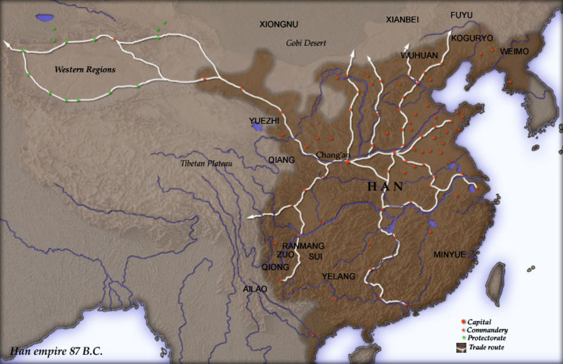

Slide 3
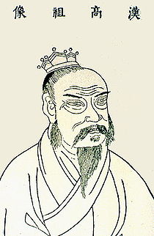
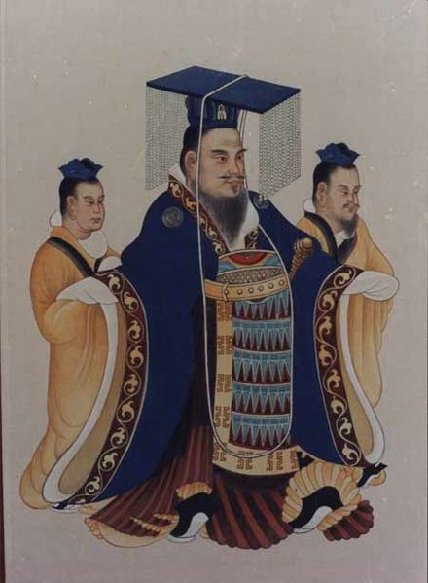
Shaping the powers of the Son of Heaven & his court
Liu Bang 劉邦 (r. 202-195 BCE): also known as Han Gaozu ("High Ancestor"). The first Han Emperor, Liu reunited the crumbled Qin empire.
Han Wudi 漢武帝(r. 141-87 BCE): the “Martial Emperor," who both brought Confucianism into the court and greatly expanded territorial boundaries.

Slide 4
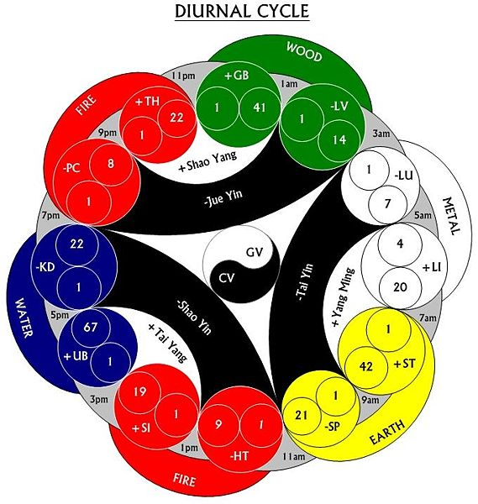
Statecraft Confucianism
A syncretic school of Han Confucian thought developed by Dong Zhongshu 董仲舒 (c.179-104 BCE) that reinforced the interactive moral relationship of Man and Heaven.

Slide 5
Emergence of the Han Meritocracy
Periodically, the central government would request recommendations for appointments to higher offices. Those recommended persons often came from successful careers in local bureaus.
The chosen candidates were taken to the central court for training, and then they were sent back to the countryside (outside of their home districts) to serve as officials.
People from low social origins could make it on they own abilities (largely excluding women).

Slide 6
System of Noble Rank
A 20-level status ranking system, through which the Han court was trying to create its own social structure.
Title of Marquis given to sons of the kings (although not first son), as well as worthy high officials and capable military leaders.
Bottom rank (#1) could be awarded to commoners.
Rank #5 and above implied that these persons were not required offer corvée labor. Punishments were offered according to the rank system.
By establishing this ranking system, the court was trying to create its own social structure:
Only noble rank counted for social status.
Land holdings, number of family members, and money didn’t count.

Slide 7
Early Han society
In many respects, Han society was not a Confucian society. Han emphasis was on the nuclear family.
Marriage and divorce was very different during the Han dynasty.
Later dynasties, women who were widowed couldn’t re-marry.
During the Han, women could call off the marriage. They could also keep the property they brought into the marriage (very different later!).
Re-marriage was very common.

Slide 8
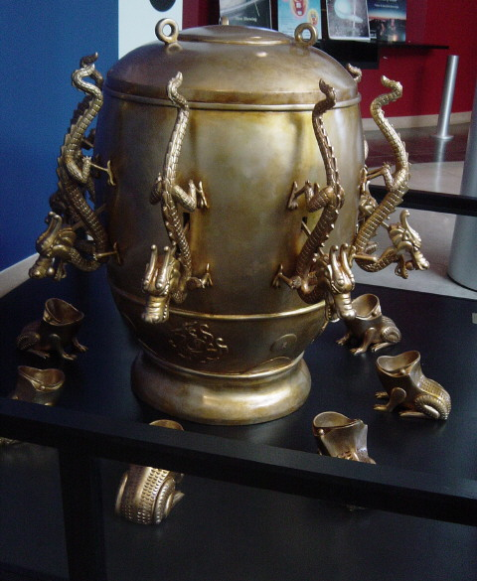
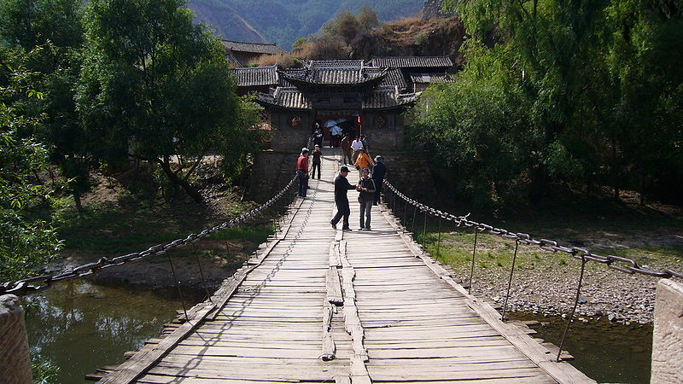
Han Technological Developments
Suspension Bridge
Seismograph
Invented by the court astronomer Zhang Heng 張衡 in CE 132.
Invented in the 1st century CE. A similar bridge wasn’t constructed in the West until 1809.

Slide 9
Han Technological Developments
The wheelbarrow: 1st century BCE.
Paper: 2nd century BCE.
A description of the circulation of blood through the body: 2nd century BCE.
The single seed drill: 2nd century BCE (This invention reached Europe 2,000 years later.)
*Note: The next age of technological innovation would come in the 11th-13th centuries during the Northern and Southern Song dynasties.
For more on the seismograph, please see U. of Main URL:http://hua.umf.maine.edu/China/astronomy/tianpage/0012ZhangHeng6539w.html

Slide 10
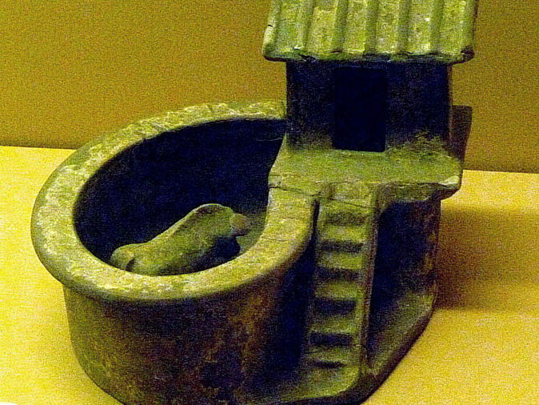
Han outhouse with attached pigsty (ceramic model) WikiCommons image

Slide 11
Agricultural Growth in the Han
The center of economic activity was the Yellow River Valley.
Crops include millet, wheat, “bok choi,” and gourds.
Intensive (great soil prep., seeding in rows, making weeding possible) ad not extensive (minimum preparation of soil and broadcast seed techniques) agriculture common.
Change in agricultural techniques led to increased productivity, which supported an increased population growth. At 1% growth per year, the Han population doubled every 70 years.
The concentration of land among several large families led to calls for land reform; however, the Han court did very little about this. Wang Mang during his aborted rule (9-23) attempted to implement reforms, but failed. Wang was the last ruler to try for the next 400 years.
Even with this problem, most of the Han population was living well.

Slide 12
